Slide 1
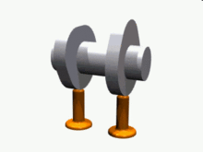
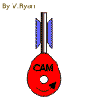
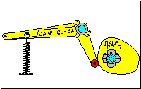
Module 5 CAMS and ANALYSIS OF CAMS

Slide 2
Module 5
Cams: Types of cams, types of followers. displacement, velocity and acceleration curves for uniform velocity, Simple Harmonic Motion, Uniform Acceleration Retradation, Cycloidal motion. Cam profiles: disc cam with reciprocating / oscillating follower having knife-edge, roller and flat-face follower inline and offset.
Analysis of Cams: Analysis of arc cam with flat faced follower. 10 Hours

Slide 3
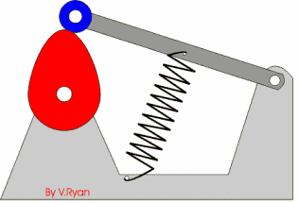
CAMS
Cam - A mechanical device used to transmit motion to a follower by direct contact.
Cam – driver; Follower - driven
In a cam - follower pair, the cam normally rotates while the follower may translate or oscillate.

Slide 4
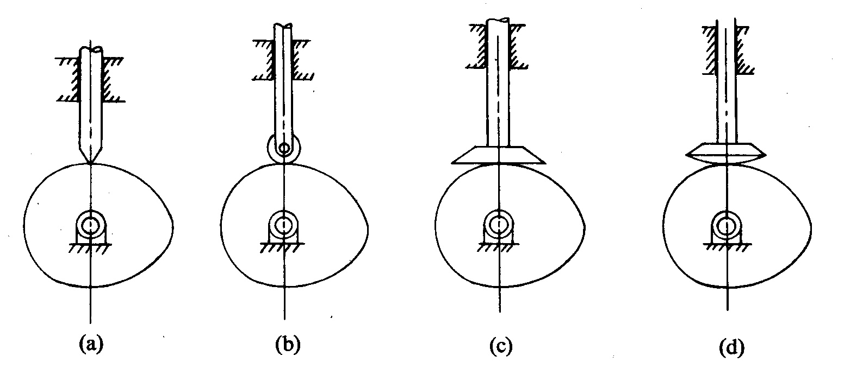
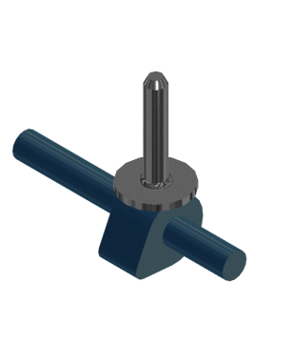
CLASSIFICATION OF FOLLOWER
1) According to the surface in contact
(a) Knife edge follower
(b) Roller follower
(c) Flat faced follower
(d) Spherical follower

Slide 5
3). According to the position of the follower
a) Radial (in line) follower

Slide 6
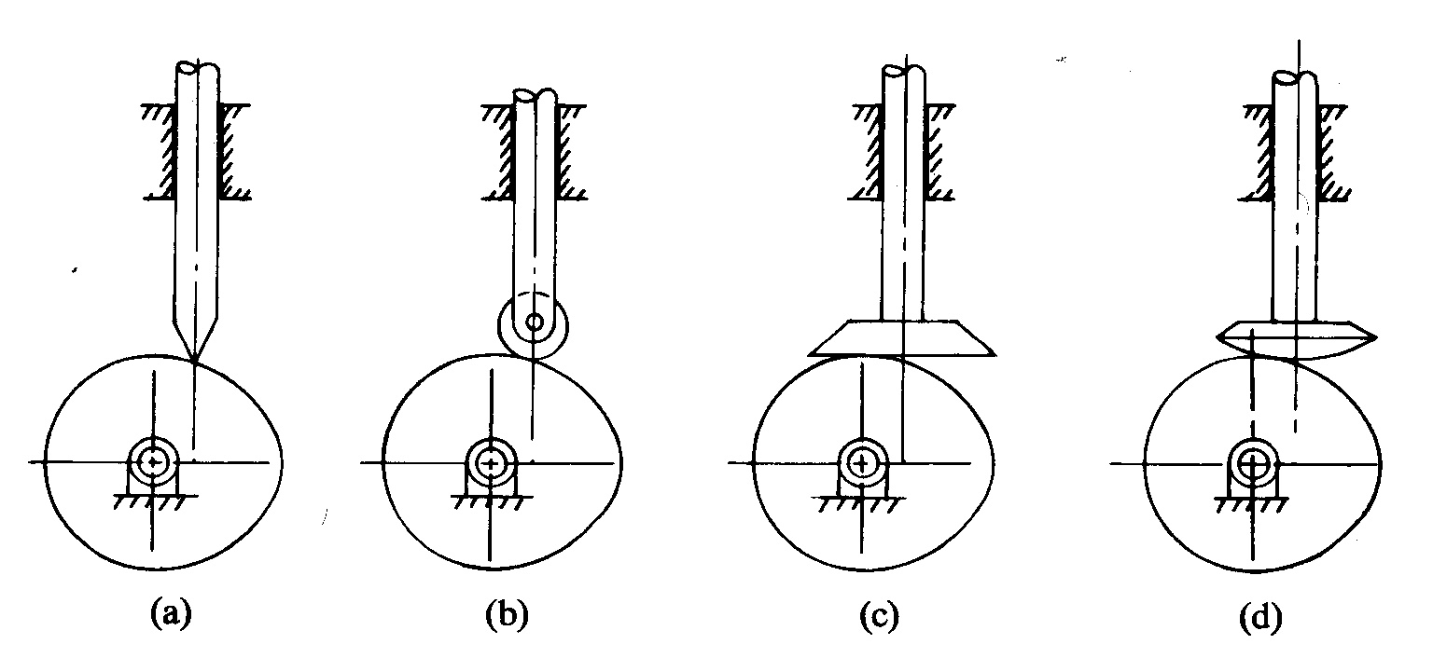
a) Offset follower

Slide 7
Motions
Rise- Cam causes follower to rise
Fall - Cam causes follower to fall
Dwell - No output motion for a specified period of input motion

Slide 8
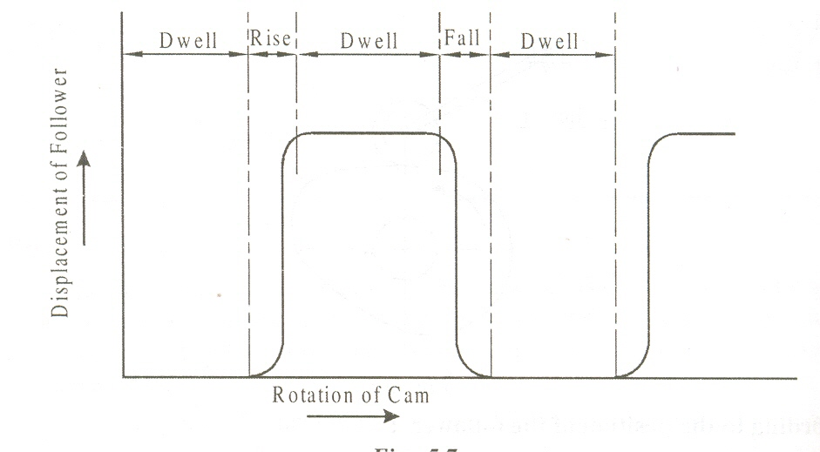
CLASSIFICATION OF CAMS
1). ACCORDING TO THE TYPE OF FOLLOWER MOTION
A). DWELL-RISE-DWELL CAM (D-R-D)

Slide 9
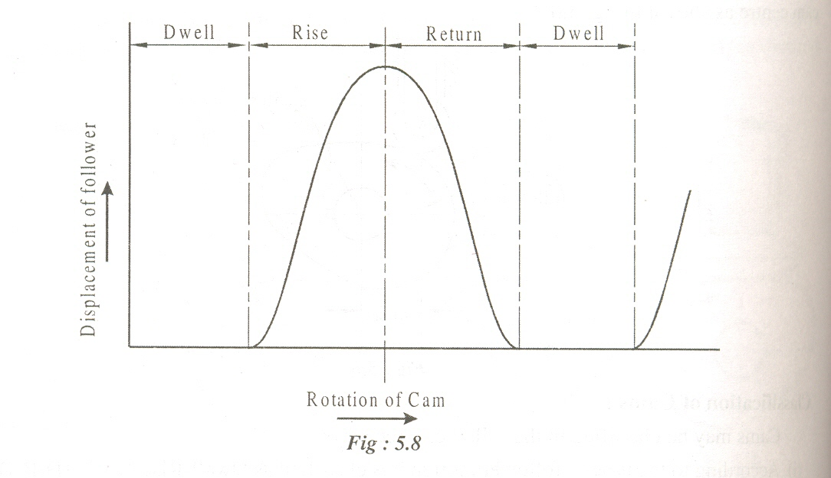
B). DWELL-RISE-RETURN-DWELL CAM (D-R-R-D)

Slide 10
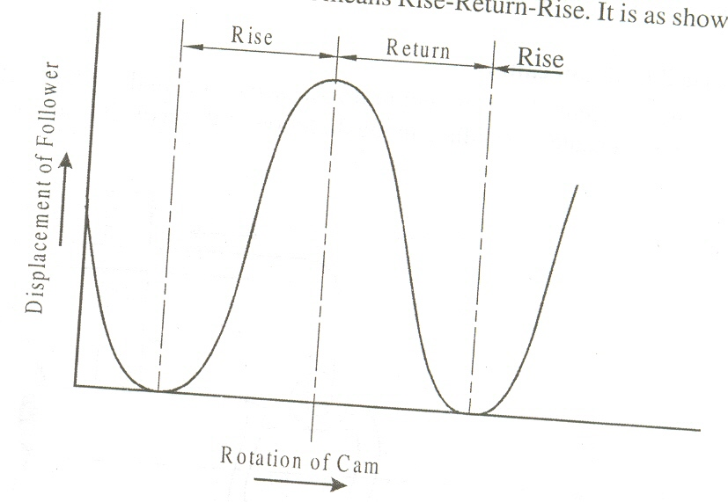
C). RISE-RETURN-RISE CAM (R-R-R)

Slide 11
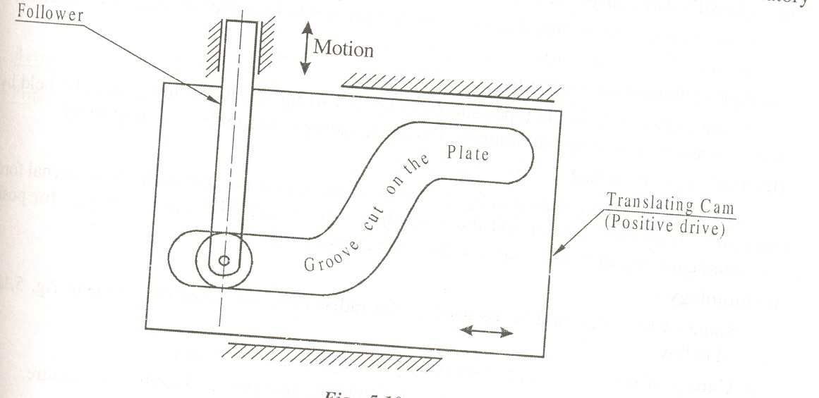
2). ACCORDING TO THE TYPE OF FOLLOWER MOTION
A). WEDGE OR FLAT CAM

Slide 12
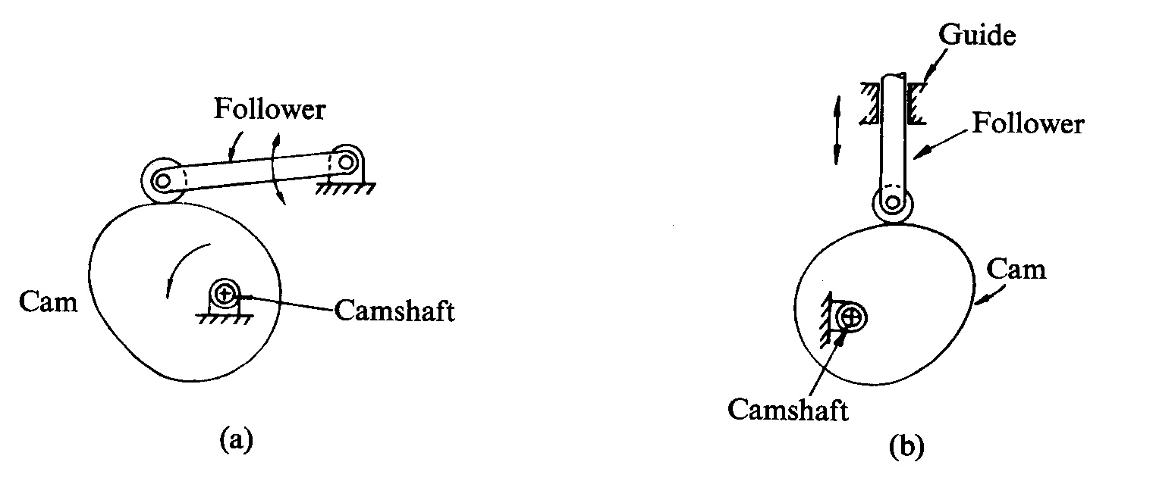
B). RADIAL OR DISC CAM

Slide 13
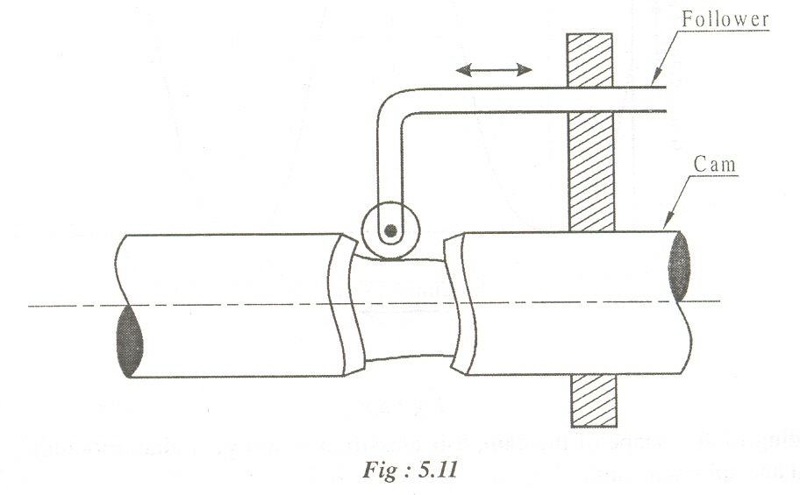
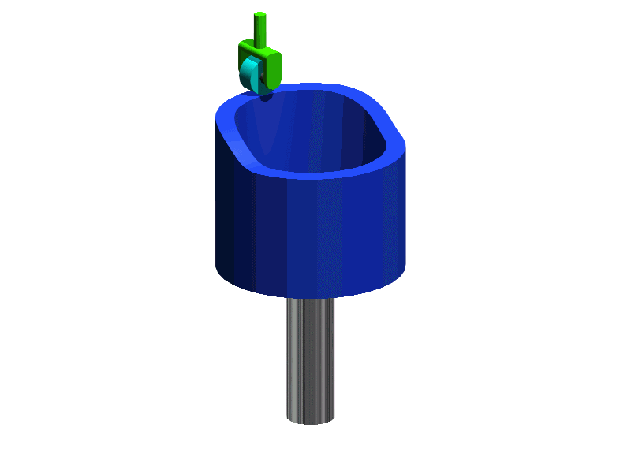
A). CYLINDRICAL OR DRUM CAM

Slide 14
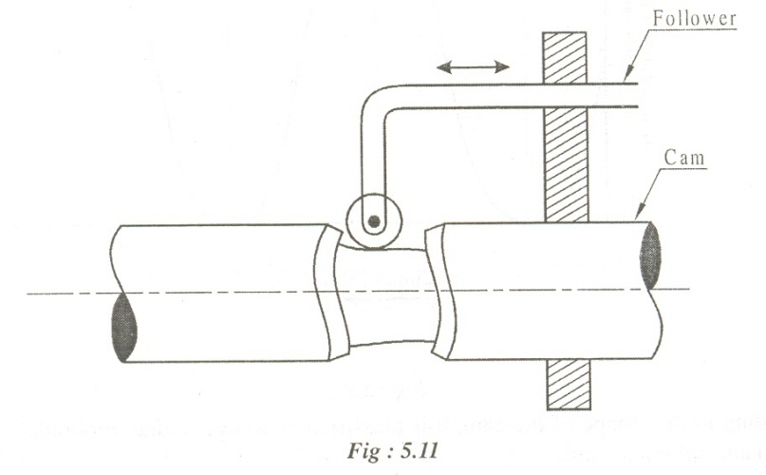
3). Classification based on constraint
A). Spring loaded or pre loaded
B). Positive constraints

Slide 15
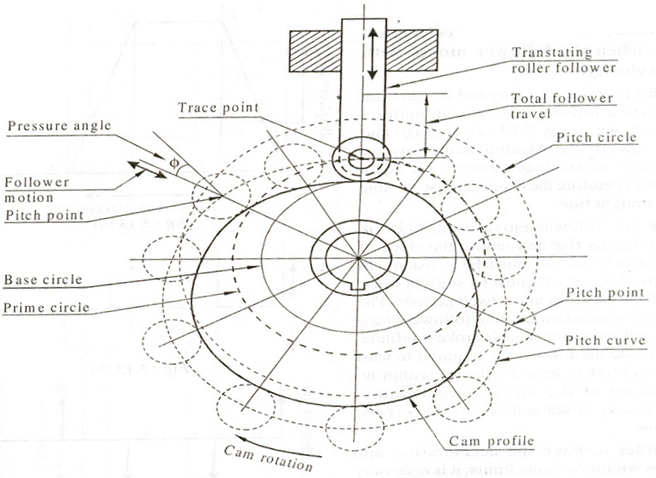
TERMINOLOGY

Slide 16
Types of follower motion
Follower motion with,
Uniform velocity
Modified uniform velocity
Uniform acceleration and deceleration
Simple harmonic motion
Cycloidal motion

Slide 17
Important Formulae:

